Slide 1
RBI analysis (what-if)
RBI what if analysis is used to see the risk that will increase if no inspection is done or it is used to check the reduction in risk status if inspection is done. This is a good indicator of inspection effectiveness.
This is to allow the user to decide about the inspections priorities the effort on high risk items.
Every year a risk run is done by the system automatically (on fixed date say 1st Jan) and the history is saved. The same can be seen by draging the pointer in the screen.
For future risk analysis user will select the year and also select the condition (say No inspection) then he will run and see the results. He can also save these results giving a name for the risk run.
The COF will not change in this analysis.
In POFof internal/external/external scc/ trendable POF s will change depending on the analysis year. SO system should run the selected Items the POF run for the selected year /priority and show the results for whatif analysis.

Slide 2
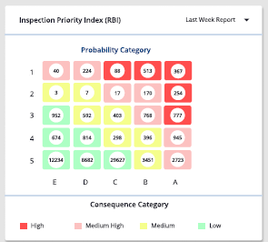
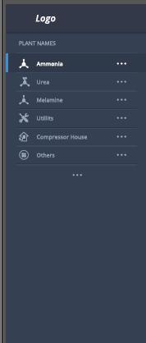
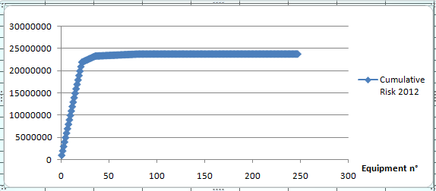
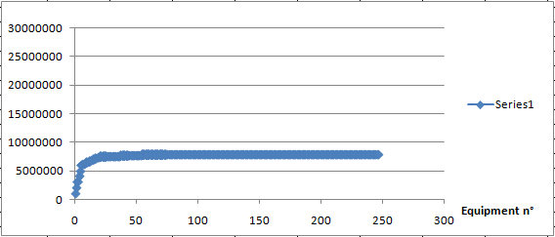
RBI-Whatif analysis
Driving Risk (as on 2020)
Projected Risk
Whatif Year
2024
Targeted Priority
18
With
No Inspection
1 VH inspection
1 High Inspection
1995 | 2000 | 2005 | 2010 | 2015 | 2020
Export
drag able
Plant | Unit | Equipment ID | Equip Type | Analysis Date | Crit Rating | Prob | Prior | Conse | Financial (€) | POF (1/Year) | Risk (€/Year) | Cumulative Risk (€/Year)
GTL | Amm1 | Pipe1 | Pipe | 11/27/2024 | HIGH | 1 | 1 | A | 10000000 | 0.1 | 1000000 | 1000000
GTL | Amm1 | Pipe2 | Pipe | 11/27/2024 | HIGH | 1 | 1 | A | 10000000 | 0.1 | 1000000 | 2000000
GTL | Amm1 | Pipe3 | Pipe | 11/27/2024 | HIGH | 1 | 1 | A | 10000000 | 0.1 | 1000000 | 3000000
GTL | Amm1 | Pipe4 | Pipe | 11/27/2024 | HIGH | 1 | 1 | A | 10000000 | 0.1 | 1000000 | 4000000
GTL | Amm1 | Pipe5 | Pipe | 11/27/2024 | HIGH | 1 | 1 | A | 10000000 | 0.1 | 1000000 | 5000000
GTL | Amm1 | Pipe6 | Pipe | 11/27/2024 | HIGH | 1 | 1 | A | 10000000 | 0.1 | 1000000 | 6000000
GTL | Amm1 | Pipe7 | Pipe | 11/27/2024 | HIGH | 1 | 2 | B | 1000000 | 0.1 | 100000 | 6100000
GTL | Amm1 | Pipe8 | Pipe | 11/27/2024 | HIGH | 1 | 2 | B | 1000000 | 0.1 | 100000 | 6200000

Slide 3
Inspection Program
For each Damage Mechanism and each priority a inspection strategy is defined as a table (example attached).
Based on the COF and POF for each DM a priority is attached as a part of RBI.
When user want to start inspection of a particular plant, he comes into this module and selects a plant/target priority and targeted year. Based on this system carryout the what-if analysis and brings the proposed inspection list of pipe lines along with proposed inspection program.
User should be able to export this list to excel or able to print the inspection history ( a data sheet will be developed including Inspection program, previous observations/ recommended actions/TML chart etc for all these lines. This will be used by user to carryout the inspections.

Slide 4
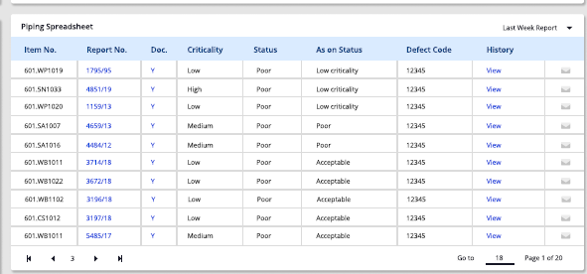
Inspection Program
Driving Risk (as on 2020)
Projected Risk
Whatif Year
2024
Targeted Priority
18
Inspection recommendation based on Targeted Priority and Year (including next Insp date)
Export
Insp Prog

